Slide 1
BSS, ASC College, Makni
Prof. Dr. Vaibhav Patange,
Dept of Chemistry

Slide 2
Chemical Bond
A Quick Review….
A bond results from the attraction of nuclei for electrons
  All atoms are trying to achieve a stable octet
IN OTHER WORDS
  the protons (+) in one nucleus are attracted to the electrons (-) of another atom
    This is Electronegativity !!

Slide 3
Three Major Types of Bonding
Ionic Bonding
  forms ionic compounds
  transfer of valence e⁻
Metallic Bonding
Covalent Bonding
  forms molecules
  sharing of valence e⁻
  This is our focus this chapter

Slide 4
Ionic Bonding
Always formed between metal cations and non-metals anions
The oppositely charged ions stick like magnets
[METALS ]⁺ [NON-METALS ]⁻
Lost e⁻
Gained e⁻

Slide 5
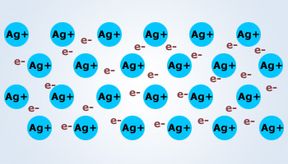
Metallic Bonding
Always formed between 2 metals (pure metals)
  Solid gold, silver, lead, etc…

Slide 6
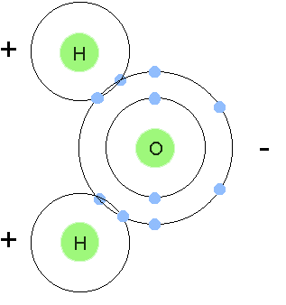
Covalent Bonding
molecules
Pairs of e- are shared between 2 non-metal atoms to acquire the electron configuration of a noble gas.

Slide 7
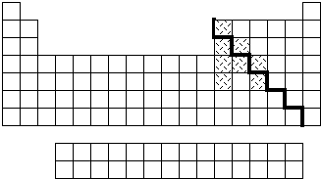
Covalent Bonding
Occurs between nonmetal atoms which need to gain electrons to get a stable octet of electrons or a filled outer shell.
nonmetals

Slide 8
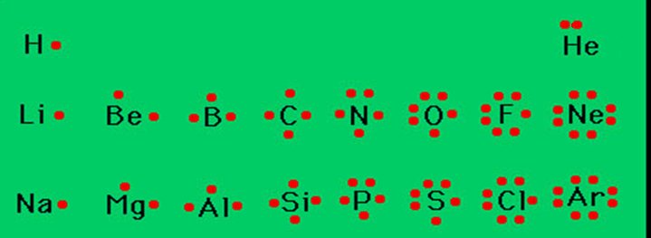
Drawing molecules (covalent) using Lewis Dot Structures
Symbol represents the KERNEL of the atom (nucleus and inner electrons)
dots represent valence electrons
The ones place of the group number indicates the number of valence electrons on an atom.
Draw a valence electron on each side (top, right, bottom, left) before pairing them.

Slide 9
Always remember atoms are trying to complete their valence shell!
“2 will do but 8 is great!”
The number of electrons the atoms needs is the total number of bonds they can make.
Ex. … H? O? F? N? Cl? C?
one two one three one four

Slide 10
Draw Lewis Dot Structures
You may represent valence electrons from different atoms with the following symbols x, ,
H or H or H
x

Slide 11
Covalent bonding
The atoms form a covalent bond by sharing their valence electrons to get a stable octet of electrons.(filled valence shell of 8 electrons)
Electron-Dot Diagrams of the atoms are combined to show the covalent bonds
Covalently bonded atoms form MOLECULES

Slide 12
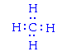
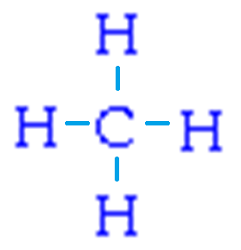
Methane CH₄
This is the finished Lewis dot structure
Every atom has a filled valence shell
How did we get here?
OR

Slide 13
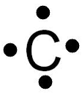

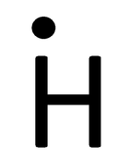
General Rules for Drawing Lewis Structures
All valence electrons of the atoms in Lewis structures must be shown.
Generally each atom needs eight electrons in its valence shell (except Hydrogen needs only two electrons and Boron needs only 6).
Multiple bonds (double and triple bonds) can be formed by C, N, O, P, and S.
Central atoms have the most unpaired electrons.
Terminal atoms have the fewest unpaired electrons.

Slide 14
When carbon is one of you atoms, it will always be in the center
Sometimes you only have two atoms, so there is no central atom
Cl₂ HBr H₂ O₂ N₂ HCl
We will use a method called ANS (Available, Needed, Shared) to help us draw our Lewis dot structures for molecules

Slide 17
Sometimes multiple bonds must be formed to get the numbers of electrons to work out
DOUBLE bond
  atoms that share two e- pairs (4 e-)
  O O
TRIPLE bond
  atoms that share three e- pairs (6 e-)
  N N

Slide 18
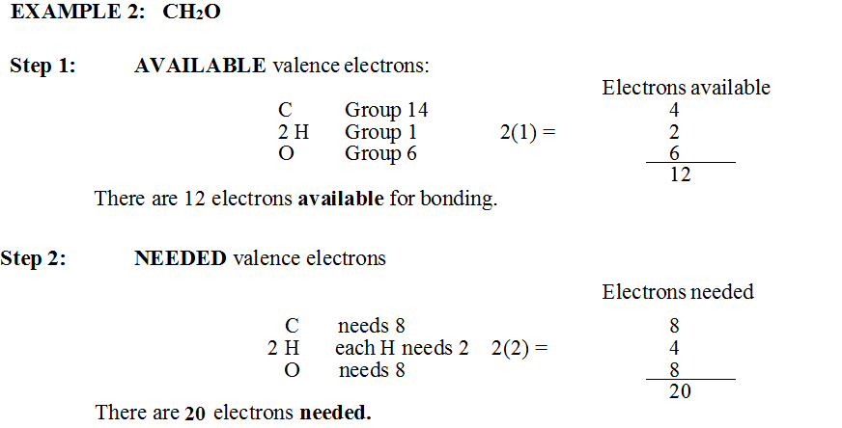

Slide 20
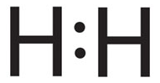
Let’s Practice
H₂
A = 1 x 2 = 2
N = 2 x 2 = 4
S = 4 - 2= 2 ÷ 2 = 1 bond
Remaining = A – S = 2 – 2 = 0
DRAW

Slide 21
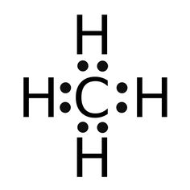
Let’s Practice
CH₄
A = C 4x1 = 4 H 1x4 = 4 4 + 4 = 8
N = C 8x1 = 8 H 2x4 = 8 8 + 8 = 16
S = (A-N)16 – 8 = 8 ÷2 = 4 bonds
Remaining = A-S = 8 – 8 = 0
DRAW

Slide 22
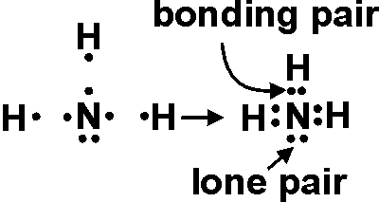
Let’s Practice
NH₃
A = N 5x1 = 5 H 1x3 = 3 = 8
N = N 8x1 = 8 H 2x3 = 6 = 14
S = 14-8 = 6 ÷2 = 3 bonds
Remaining = (A-S) 8 – 6 = 2
DRAW

Slide 23
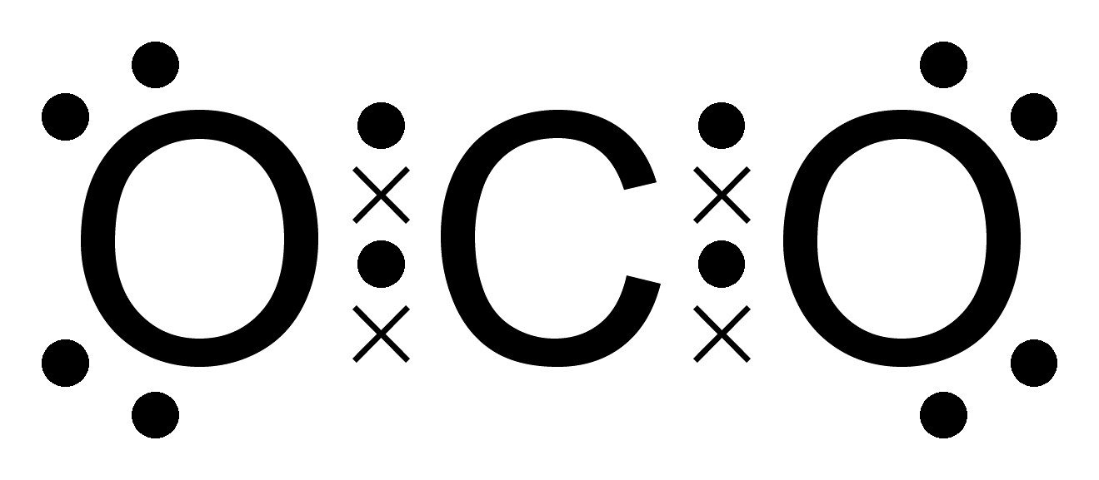
Let’s Practice
CO₂
A = C 4x1 = 4 O 6x2 = 12 = 16
N = C 8x1 = 8 O 8x2 = 16 = 24
S = 24-16 = 8 ÷ 2 = 4 bonds
Remaining = (A-S) 16 – 8 = 8 not bonding
DRAW – carbon is the central atom

Slide 24
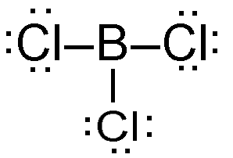
Let’s Practice
BCl₃ boron only needs 6 valence electrons, it is an exception.
A = B 3 x 1 = 3 Cl 7 x 3 = 21 = 24
N = B(6) x 1 = 6 Cl 8 x 3 = 24 = 30
S = 30-24 = 6 ÷ 2 = 3 bonds
Remaining = 24 – 6 = 18 e- not bonding
DRAW

Slide 25
Naming Molecular Compounds (Covalent)
Type III
Nonmetal + nonmetal

Slide 26
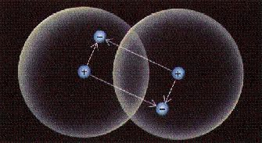
The Covalent Bond
Sharing of electrons

Slide 27
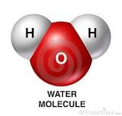
Properties of Molecular or Covalent Compounds
Made from 2 or more non­metals
Consist of molecules not ions

Slide 28
Molecular Formulas
Show the kinds and numbers of atoms present in a molecule of a compound.
Molecular Formula = H₂O

Slide 29
Structural formula
H N H
H
NH₃
Molecular formula

Slide 30
Molecular Formulas
Examples
CO₂
SO₃
N₂O₅

Slide 31
Rules for Naming
Molecular compounds
The most “metallic” nonmetal element is written first (the one that is furthest left)
The most non­metallic of the two nonmetals is written last in the formula
NO₂ not O₂N
All binary molecular compounds end in -­ide

Slide 32
Molecular compounds
Ionic compounds use charges to determine the chemical formula
The molecular compound‘s name tells you the number of each element in the chemical formula.
Uses prefixes to tell you the quantity of each element.
You need to memorize the prefixes !

Slide 33
Prefixes
1 mono­
2 di­
3 tri­
4 tetra­
5 penta­
6 hexa­
7 hepta­
8 octa­
9 nona­
10 deca­
Memorize!

Slide 34
More Molecular Compound Rules
If there is only one of the first element do not put (prefix) mono­
Example: carbon monoxide (not monocarbon monoxide)
  If the nonmetal starts with a vowel, drop the vowel ending from all prefixes except di and tri
    monoxide not monooxide
    tetroxide not tetraoxide

Slide 35
Molecular compounds
N₂O₅

Slide 36
Molecular compounds
N₂O₅
di

Slide 37
Molecular compounds
N₂O₅
dinitrogen

Slide 38

Molecular compounds
N₂O₅
dinitrogen
penta

Slide 39
Molecular compounds
N₂O₅
dinitrogen
pentaoxide

Slide 40
Molecular compound Naming Practice
N₂O₅
dinitrogen
pentaoxide

Slide 41
Molecular compounds
N₂O₅
dinitrogen pentoxide
dinitrogen pentoxide

Slide 42
Molecular compounds Sulfur trioxide

Slide 43
Molecular compounds
Sulfur trioxide
S

Slide 44
Molecular compounds
Sulfur trioxide
S

Slide 45
Molecular compounds
Sulfur trioxide
S
O₃

Slide 46
Molecular compounds Sulfur trioxide
S
O₃
SO₃

Slide 47
Molecular compounds
CCl₄

Slide 48
Molecular compounds
CCl₄
monocarbon

Slide 49
Molecular compounds
CCl₄
monocarbon

Slide 50
Molecular compounds
CCl₄
carbon

Slide 51
Molecular compounds
CCl₄
tetra
carbon

Slide 52
Molecular compounds
CCl₄
tetrachloride
carbon

Slide 53
Molecular compounds
CCl₄
tetrachloride
carbon
Carbon tetrachloride

Slide 54
Write molecular formulas for these
diphosphorus pentoxide
  P₂O₅
trisulfur hexaflouride
  S₃F₆
nitrogen triiodide
  NI₃

Slide 55
Common Names
H₂O NH₃

Slide 56
Common Names
H₂O
Water
NH₃
Ammonia

Slide 58
Bond Types
3 Possible Bond Types:
  Ionic
  Non-Polar Covalent
  Polar Covalent

Slide 59
Use Electronegativity Values to Determine Bond Types
Ionic bonds
  Electronegativity (EN) difference > 2.0
Polar Covalent bonds
  EN difference is between .21 and 1.99
Non-Polar Covalent bonds
  EN difference is < .20
  Electrons shared evenly in the bond

Slide 60
Ionic Character
“Ionic Character” refers to a bond’s polarity
  In a polar covalent bond,
    the closer the EN difference is to 2.0, the more POLAR its character
    The closer the EN difference is to .20, the more NON-POLAR its character

Slide 61
Place these molecules in order of increasing bond polarity using the electronegativity values on your periodic table
HCl
CH₄
CO₂
NH₃
N₂
HF
3 EN difference = 0.9
2 EN difference = 0.4
a.k.a.
“ionic character”
4 EN difference = 1.0
3 EN difference = 0.9
1 EN difference = 0
5 EN difference = 1.9

Slide 62
Polar vs. Nonpolar MOLECULES
Sometimes the bonds within a molecule are polar and yet the molecule itself is non-polar

Slide 63
Nonpolar Molecules
Molecule is Equal on all sides
  Symmetrical shape of molecule (atoms surrounding central atom are the same on all sides)
Draw Lewis dot first and
see if equal on all sides
H
H
C
H
H

Slide 64
Polar Molecules
Molecule is Not Equal on all sides
  Not a symmetrical shape of molecule (atoms surrounding central atom are not the same on all sides)
Cl
H
C
H
H
Notes:
PER 5 11/14/2107

Slide 65
Polar Molecule
H
Cl
δ⁺
δ⁻
Unequal Sharing of Electrons

Slide 66
Non-Polar Molecule
Cl
Cl
Equal Sharing of Electrons

Slide 67
Polar Molecule
H
Cl
B
H
Not symmetrical

Slide 68
Non-Polar Molecule
H
H
B
H
Symmetrical

Slide 69
Water is a POLAR molecule
ANY time there are unshared pairs of electrons on the central atom, the molecule is POLAR
O
H
H

Slide 70
Making sense of the polar non-polar thing
BONDS
Non-polar Polar
EN difference EN difference
0 - .2 .21 – 1.99
MOLECULES
Non-polar Polar
Symmetrical Asymmetrical
OR
Unshared e⁻s on Central Atom

Slide 71
5 Shapes of Molecules you must know!
(memorize)

Slide 72
Copy this slide
VSEPR – Valence Shell Electron Pair Repulsion Theory
  Covalent molecules assume geometry that minimizes repulsion among electrons in valence shell of atom
  Shape of a molecule can be predicted from its Lewis Structure

Slide 73

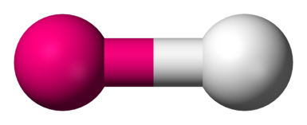
1. Linear (straight line)
Ball and stick model
OR
Molecule geometry X A X
OR
A X
Shared Pairs = 2 Unshared Pairs = 0

Slide 74
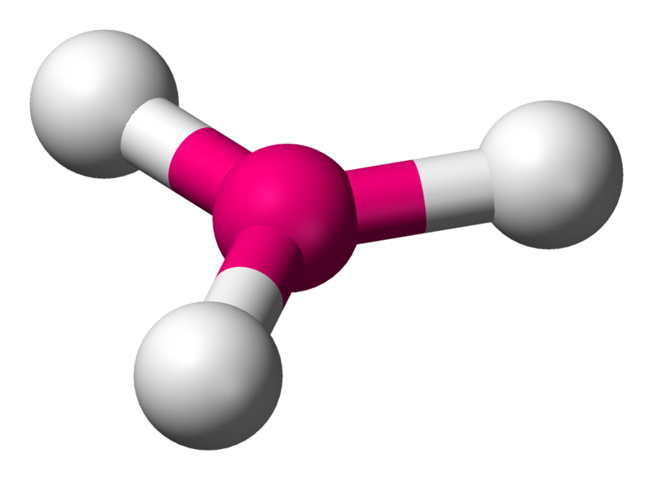
2. Trigonal Planar
Ball and stick model
Molecule geometry X
A
X X
Shared Pairs = 3 Unshared Pairs = 0

Slide 75
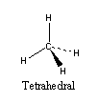
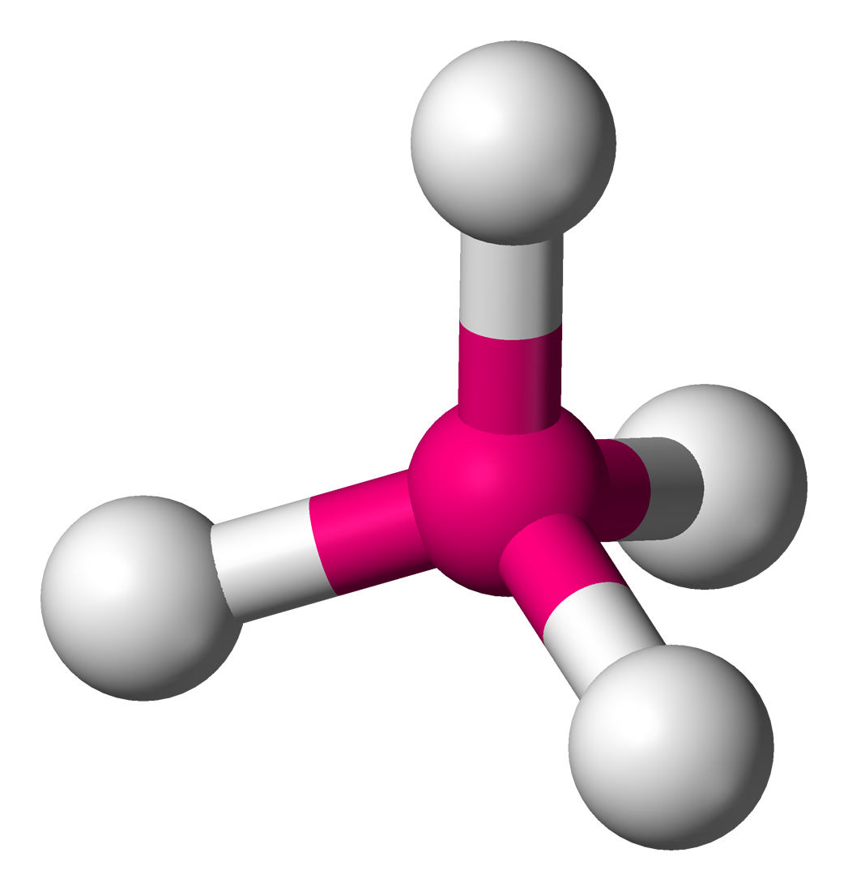
3.Tetrahedral
Ball and stick model
Molecule geometry
Shared Pairs = 4 Unshared Pairs = 0

Slide 76
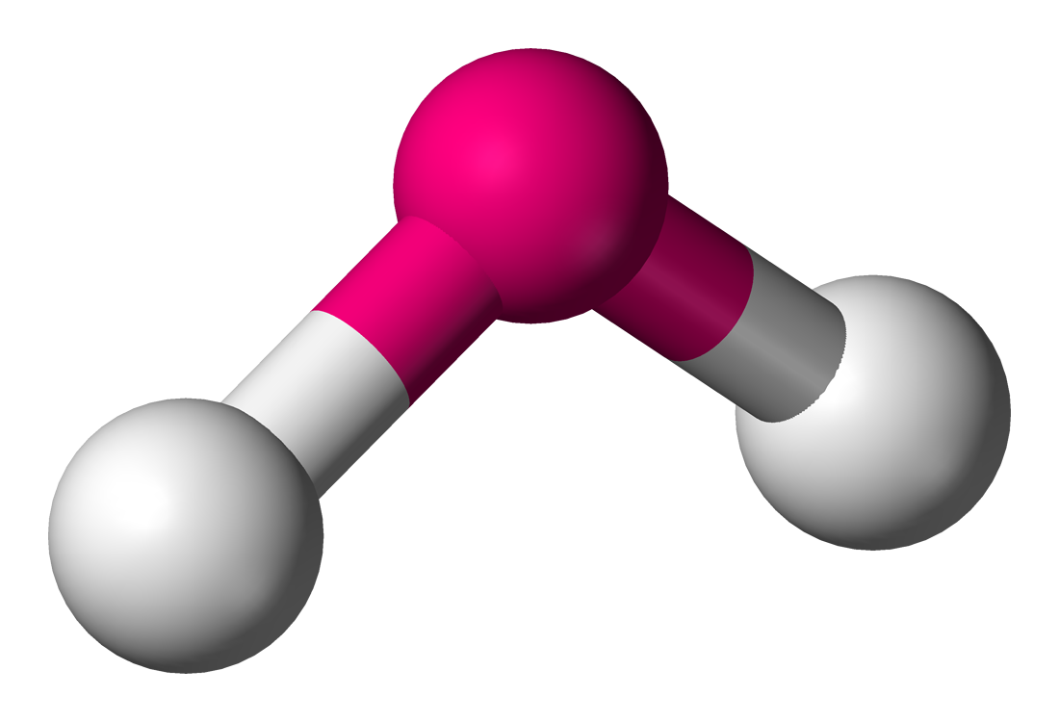
4. Bent
Ball and stick model
..
Lewis Diagram A
X X
Shared Pairs = 2 Unshared Pairs = 1 or 2

Slide 77
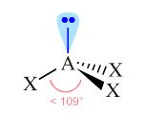
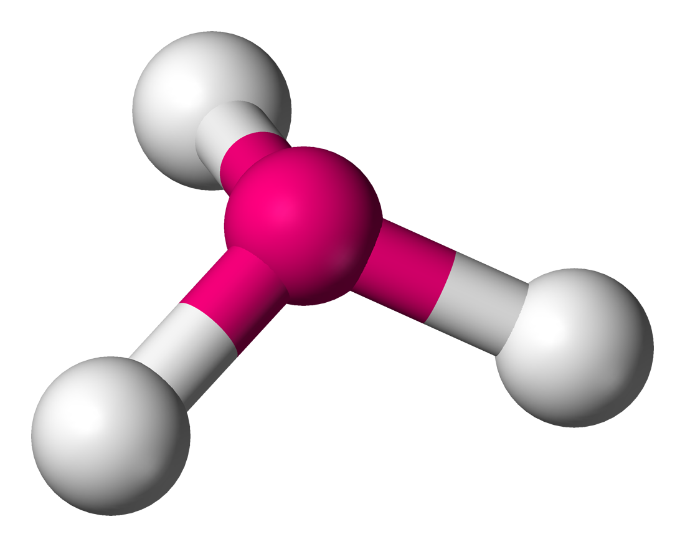
5.Trigonal Pyramidal
Ball and stick model
Molecule geometry
Shared Pairs = 3 Unshared Pairs = 1

Slide 78
I can describe the 3 intermolecular forces of covalent compounds and explain the effects of each force.

Slide 79
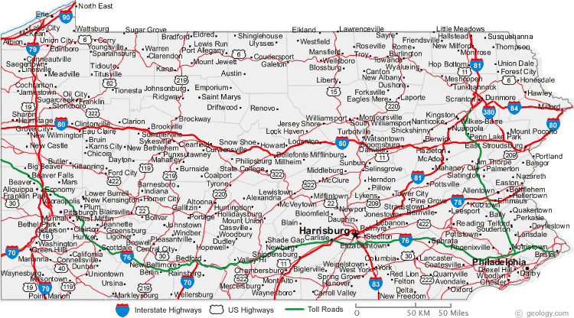
Intramolecular attractions
Attractions within or inside molecules, also known as bonds.
  Ionic
  Covalent
  metallic
Roads within a state

Slide 80
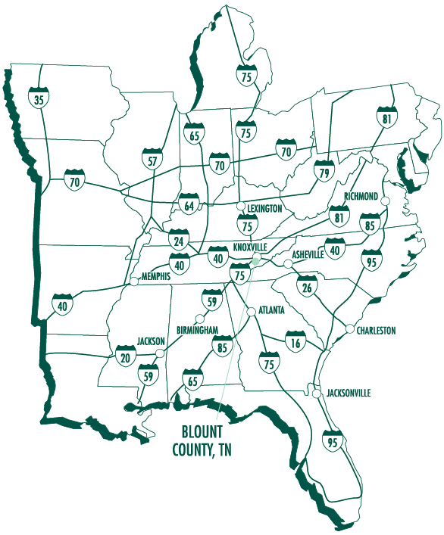
Intermolecular attractions
Attractions between molecules
  Hydrogen “bonding”
    Strong attraction between special polar molecules (F, O, N, P)
  Dipole-Dipole
    Result of polar covalent Bonds
  Induced Dipole (Dispersion Forces)
    Result of non-polar covalent bonds

Slide 81
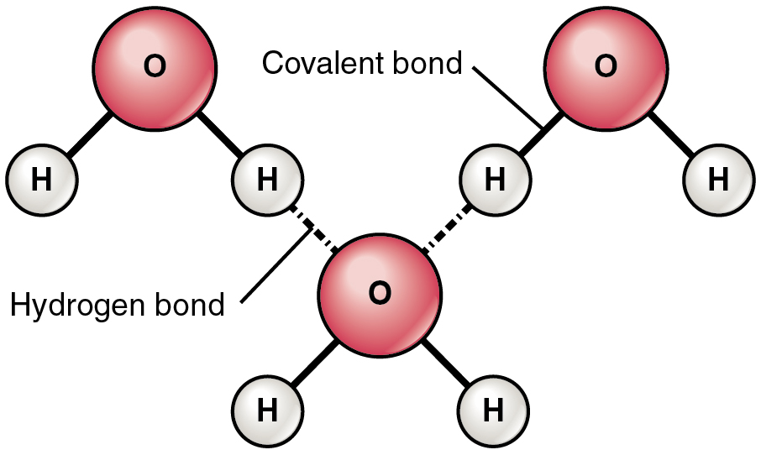
More on intermolecular forces Hydrogen “Bonding”
STRONG intermolecular force
  Like magnets
Occurs ONLY between H of one molecule and N, O, F of another molecule
δ⁻
δ⁻
δ⁺
δ⁺
δ⁺
δ⁺
δ⁻
δ⁺
δ⁺
Hydrogen “bond”
Hydrogen bonding
1 min

Slide 82
Why does Hydrogen “bonding” occur?
Nitrogen, Oxygen and Fluorine
  are small atoms with strong nuclear charges
    powerful atoms
  Have very high electronegativities, these atoms hog the electrons in a bond
  Create very POLAR molecules

Slide 83
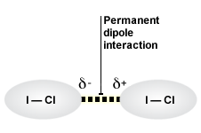
Dipole-Dipole Interactions
  WEAK intermolecular force
  Bonds have high EN differences forming polar covalent molecules, but not as high as those that result in hydrogen bonding. .21<EN<1.99
  Partial negative and partial positive charges slightly attracted to each other.
  Only occur between polar covalent molecules

Slide 84
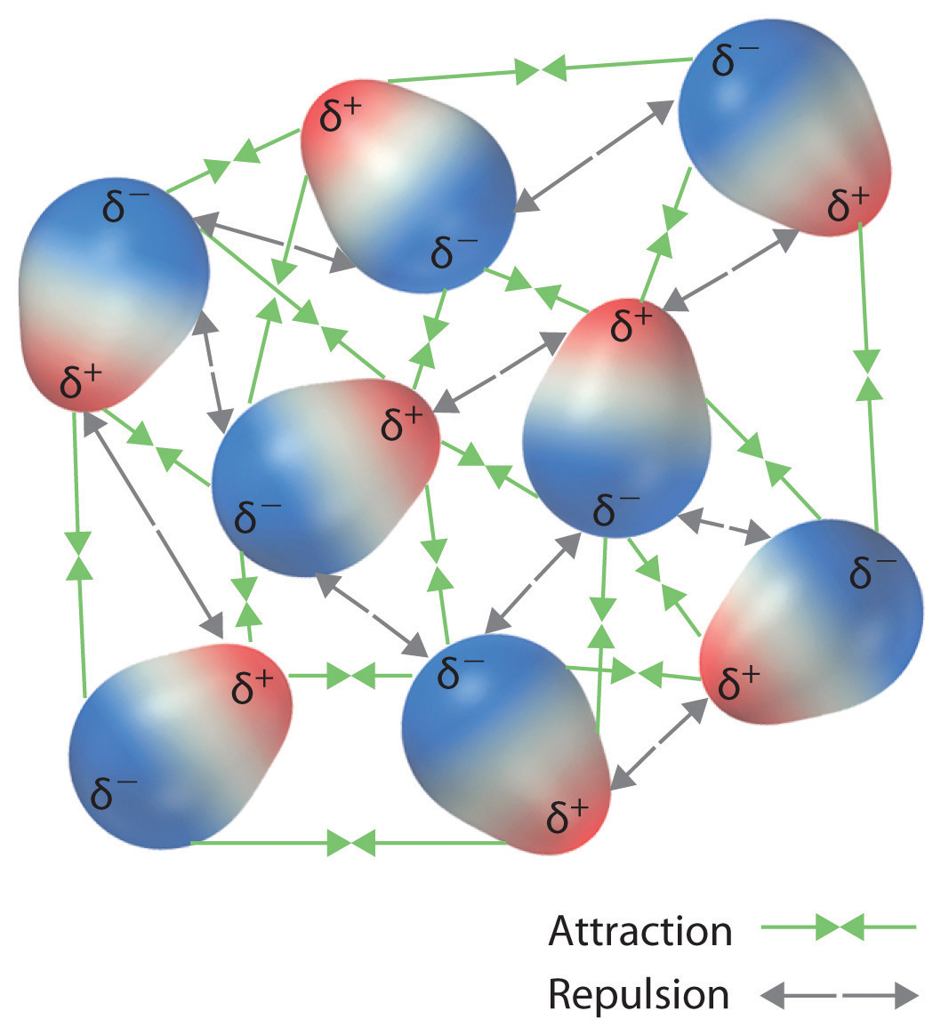
Dipole-Dipole Interactions

Slide 85
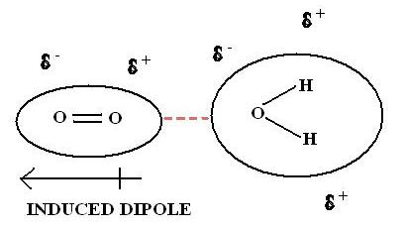
Induced Dipole Attractions
  VERY WEAK intermolecular force
  Bonds have low EN differences EN < .20
  Temporary partial negative or positive charge results from a nearby polar covalent molecule.
  Only occur between NON-POLAR & POLAR molecules
Induced dipole video
30 sec

Slide 86
BOND STRENGTH
Strongest
{
  IONIC
  COVALENT
  Hydrogen
  Dipole-Dipole
  Induced Dipole
intramolecular
{
intermolecular
Weakest

Slide 87
Intermolecular Forces affect chemical properties
For example, strong intermolecular forces cause high Boiling Point
  Water has a high boiling point compared to many other liquids

Slide 88
Which substance has the highest boiling point?
HF
NH₃
CO₂
WHY?

Slide 89
Which substance has the highest boiling point?
HF
NH₃
CO₂
WHY?
The H-F bond has the highest electronegativity difference SO
HF has the most polar bond resulting in the strongest H bonding (and therefore needs the most energy to overcome the intermolecular forces and boil)

