Slide 1
Cell Structure and Function
Prof. Sanjay R. Biradar
Head, Dept. of Botany
B.S.S.College,Makani-413604,
Dist.Osmanabad (M.S.) INDIA

Slide 2
Chapter Outline
Cell theory
Properties common to all cells
Cell size and shape – why are cells so small?
Prokaryotic cells
Eukaryotic cells
  Organelles and structure in all eukaryotic cell
  Organelles in plant cells but not animal
Cell junctions

Slide 3
History of Cell Theory
mid 1600s – Anton van Leeuwenhoek
  Improved microscope, observed many living cells
mid 1600s – Robert Hooke
  Observed many cells including cork cells
1850 – Rudolf Virchow
  Proposed that all cells come from existing cells

Slide 4
Cell Theory
All organisms consist of 1 or more cells.
Cell is the smallest unit of life.
All cells come from pre-existing cells.

Slide 5
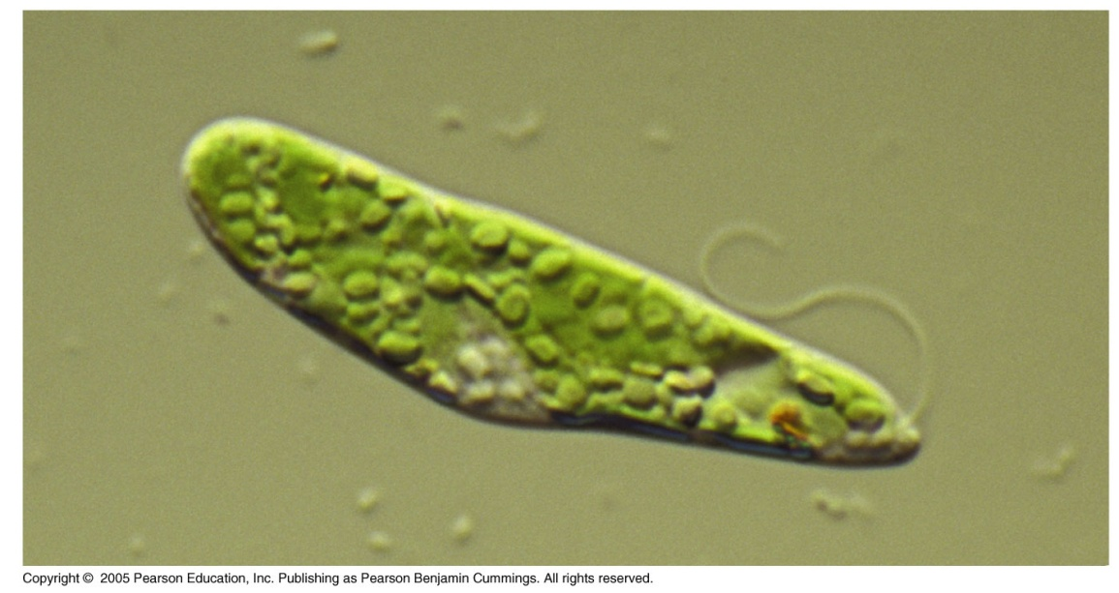
Observing Cells (4.1)
Light microscope
  Can observe living cells in true color
  Magnification of up to ~1000x
  Resolution ~ 0.2 microns – 0.5 microns

Slide 6
Observing Cells (4.1)
Electron Microscopes
  Preparation needed kills the cells
  Images are black and white – may be colorized
  Magnifcation up to ~100,000
    Transmission electron microscope (TEM)
      2-D image
    Scanning electron microscope (SEM)
      3-D image

Slide 7
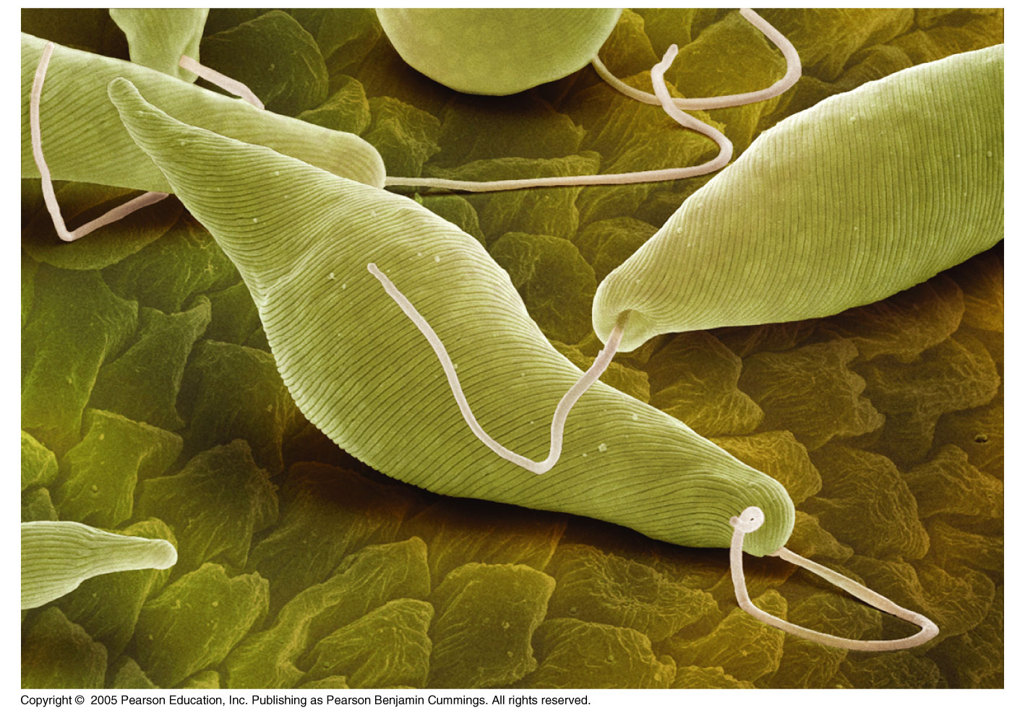
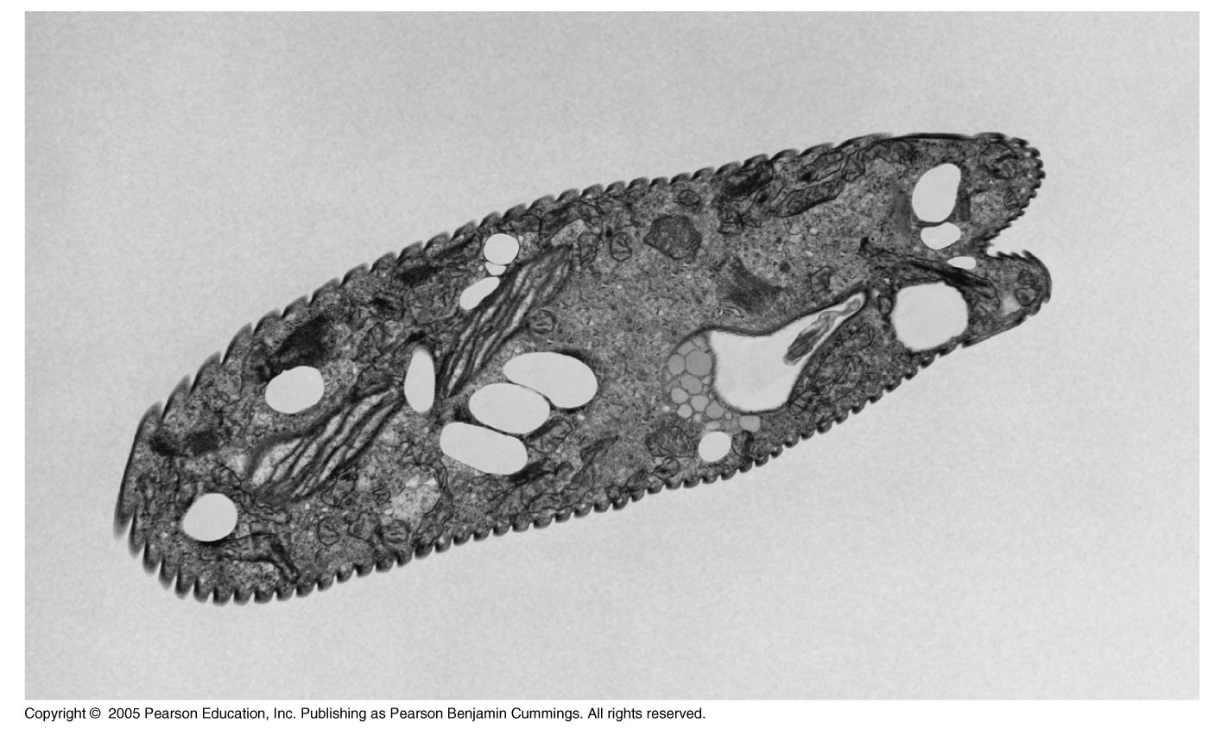
SEM
TEM

Slide 8
Cell Structure
All Cells have:
  an outermost plasma membrane
  genetic material in the form of DNA
  cytoplasm with ribosomes

Slide 9
1. Plasma Membrane
    All membranes are phospholipid bilayers with embedded proteins
    The outer plasma membrane
      isolates cell contents
      controls what gets in and out of the cell
      receives signals

Slide 10
2. Genetic material in the form of DNA
  Prokaryotes – no membrane around the DNA
  Eukaryotes – DNA is within a membrane

Slide 11
3. Cytoplasm with ribosomes
  Cytoplasm – fluid area inside outer plasma membrane and outside DNA region
  Ribosomes – make proteins

Slide 12
Cell Structure
All Cells have:
  an outermost plasma membrane
  genetic material in the form of DNA
  cytoplasm with ribosomes

Slide 13
Why Are Cells So Small? (4.2)
Cells need sufficient surface area to allow adequate transport of nutrients in and wastes out.
As cell volume increases, so does the need for the transporting of nutrients and wastes.

Slide 14
Why Are Cells So Small?
However, as cell volume increases the surface area of the cell does not expand as quickly.
  If the cell’s volume gets too large it cannot transport enough wastes out or nutrients in.
Thus, surface area limits cell volume/size.

Slide 15
Why Are Cells So Small?
Strategies for increasing surface area, so cell can be larger:
  “Frilly” edged…….
  Long and narrow…..
Round cells will always be small.

Slide 16
Prokaryotic Cell Structure
Prokaryotic Cells are smaller and simpler in structure than eukaryotic cells.
  Typical prokaryotic cell is __________
  Prokaryotic cells do NOT have:
    Nucleus
    Membrane bound organelles

Slide 17
Prokaryotic Cell Structure
Structures
  Plasma membrane
  Cell wall
  Cytoplasm with ribosomes
  Nucleoid
  Capsule*
  Flagella* and pili*
  *present in some, but not all prokaryotic cells

Slide 18
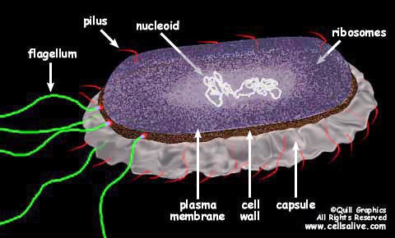
Prokaryotic Cell

Slide 19
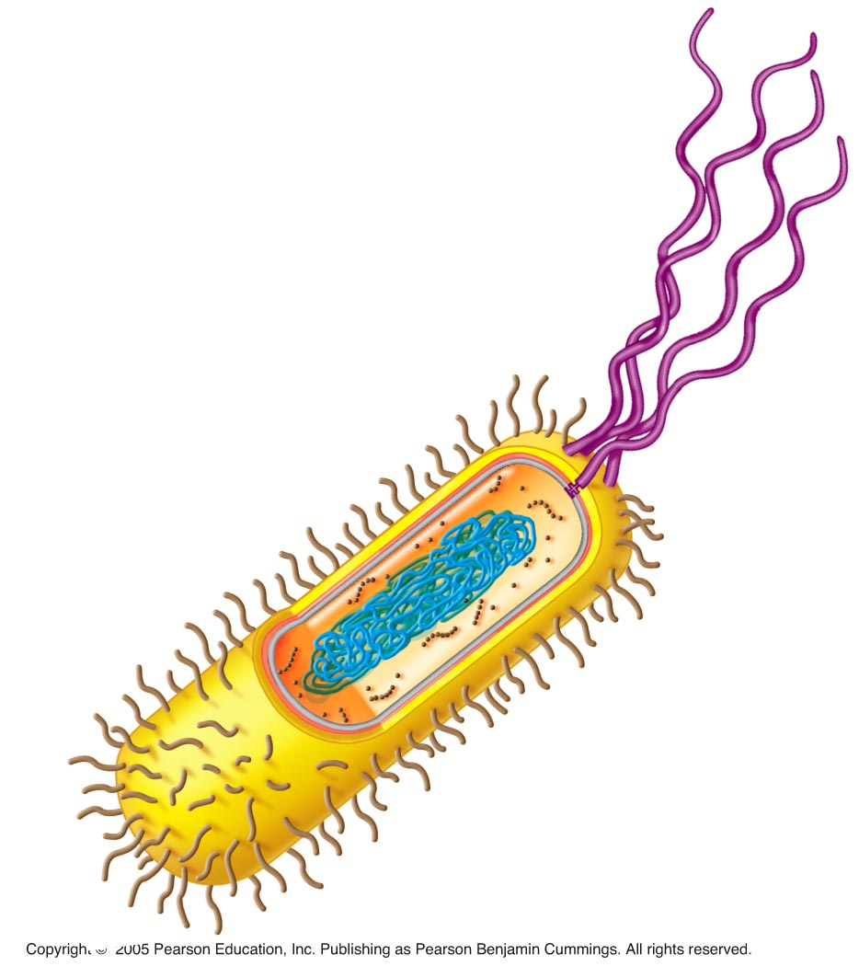

Slide 20
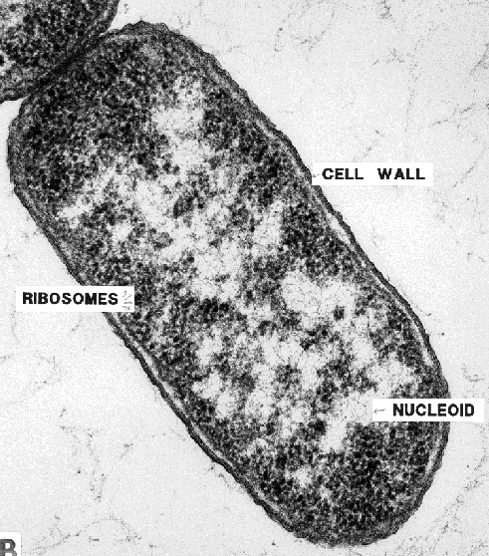
TEM Prokaryotic Cell

Slide 21
Eukaryotic Cells
Structures in all eukaryotic cells
  Nucleus
  Ribosomes
  Endomembrane System
    Endoplasmic reticulum – smooth and rough
    Golgi apparatus
    Vesicles
  Mitochondria
  Cytoskeleton

Slide 22
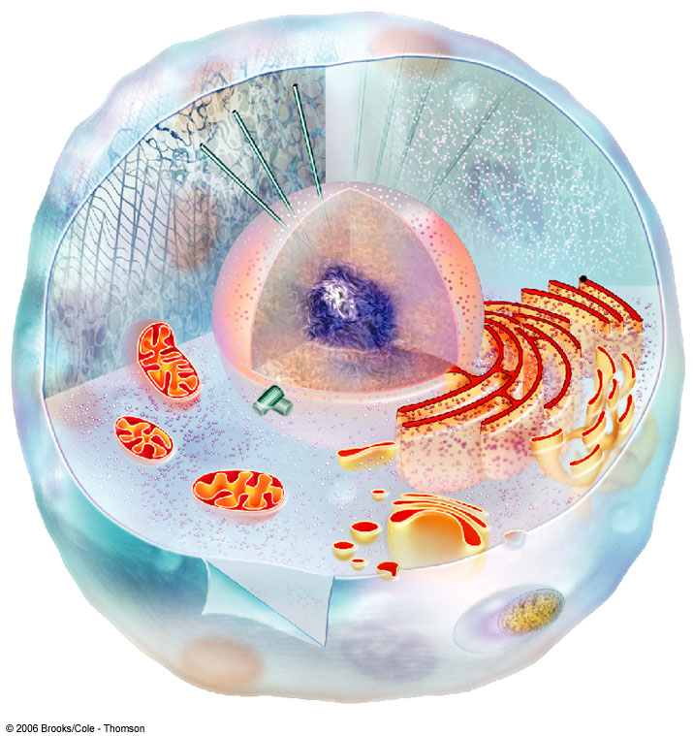
NUCLEUS
CYTOSKELETON
RIBOSOMES
MITOCHONDRION
ROUGH ER
CYTOPLASM
SMOOTH ER
CENTRIOLES
GOLGI BODY
PLASMA MEMBRANE
LYSOSOME
VESICLE
Fig. 4-15b, p.59

Slide 23
Nucleus (4.5)
Function – isolates the cell’s genetic material, DNA
  DNA directs/controls the activities of the cell
    DNA determines which types of RNA are made
    The RNA leaves the nucleus and directs the synthesis of proteins in the cytoplasm at a ______________

Slide 24
Nucleus
Structure
  Nuclear envelope
    Two Phospholipid bilayers with protein lined pores
      Each pore is a ring of 8 proteins with an opening in the center of the ring
  Nucleoplasm – fluid of the nucleus

Slide 25
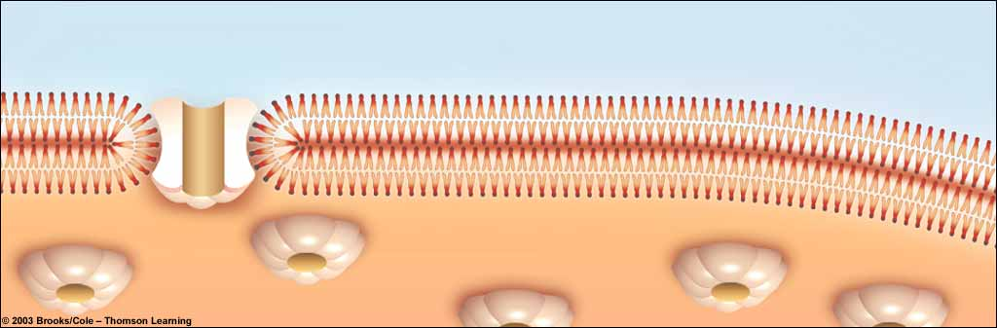
Nuclear pore
bilayer facing cytoplasm
Nuclear envelope
bilayer facing nucleoplasm
Fig. 4-17, p.61

Slide 26
Nucleus
DNA is arranged in chromosomes
  Chromosome – fiber of DNA with proteins attached
  Chromatin – all of the cell’s DNA and the associated proteins

Slide 27
Nucleus
Structure, continued
  Nucleolus
    Area of condensed DNA
    Where ribosomal subunits are made
      Subunits exit the nucleus via nuclear pores

Slide 28
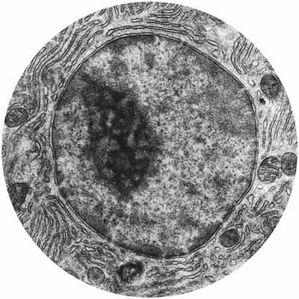
ADD
THE
LABELS

Slide 29
Endomembrane System (4.6 – 4.9)
Series of organelles responsible for:
  Modifying protein chains into their final form
  Synthesizing of lipids
  Packaging of fully modified proteins and lipids into vesicles for export or use in the cell
  And more that we will not cover!

Slide 30
Structures of the
Endomembrane System
Endoplasmic Reticulum (ER)
  Continuous with the outer membrane of the nuclear envelope
  Two forms - smooth and rough
Transport vesicles
Golgi apparatus

Slide 31
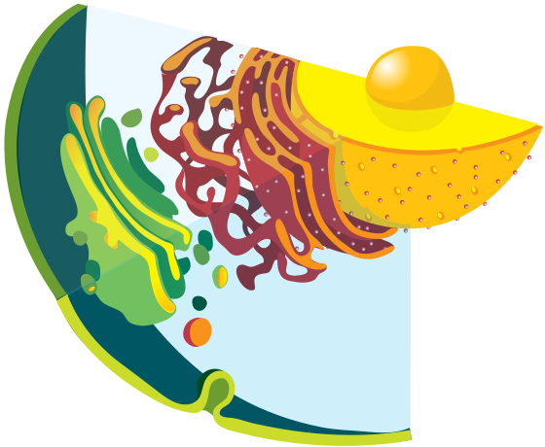

Slide 32
Endoplasmic Reticulum (ER)
  The ER is continuous with the outer membrane of the nuclear envelope
  There are 2 types of ER:
    Rough ER – has ribosomes attached
    Smooth ER – no ribosomes attached

Slide 33
Endoplasmic Reticulum
Rough Endoplasmic Reticulum (RER)
    Network of flattened membrane sacs create a “maze”
      RER contains enzymes that recognize and modify proteins
    Ribosomes are attached to the outside of the RER and make it appear rough

Slide 34
Endoplasmic Reticulum
Function RER
    Proteins are modified as they move through the RER
    Once modified, the proteins are packaged in transport vesicles for transport to the Golgi body

Slide 35
Endomembrane System
Smooth ER (SER)
  Tubular membrane structure
  Continuous with RER
  No ribosomes attached
Function SER
  Lipids are made inside the SER
    fatty acids, phospholipids, sterols..
  Lipids are packaged in transport vesicles and sent to the Golgi

Slide 36
Golgi Apparatus
Golgi Apparatus
  Stack of flattened membrane sacs
Function Golgi apparatus
  Completes the processing substances received from the ER
  Sorts, tags and packages fully processed proteins and lipids in vesicles

Slide 37
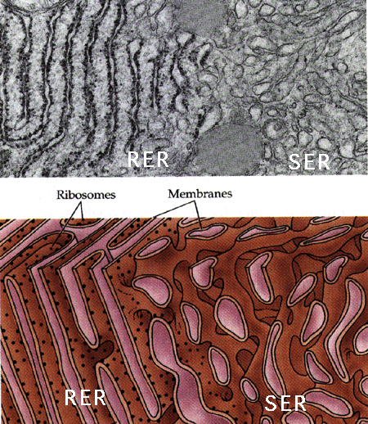

Slide 38
Golgi Apparatus
Golgi apparatus receives transport vesicles from the ER on one side of the organelle
  Vesicle binds to the first layer of the Golgi and its contents enter the Golgi

Slide 39
Golgi Apparatus
  The proteins and lipids are modified as they pass through layers of the Golgi
  Molecular tags are added to the fully modified substances
    These tags allow the substances to be sorted and packaged appropriately.
    Tags also indicate where the substance is to be shipped.

Slide 40
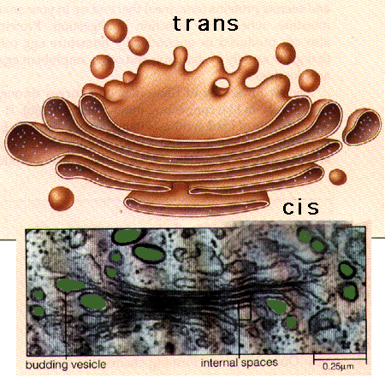
Golgi Apparatus

Slide 41
Transport Vesicles
Transport Vesicles
  Vesicle = small membrane bound sac
  Transport modified proteins and lipids from the ER to the Golgi apparatus (and from Golgi to final destination)

Slide 42
Endomembrane System
Putting it all together
  DNA directs RNA synthesis → RNA exits nucleus through a nuclear pore → ribosome → protein is made → proteins with proper code enter RER → proteins are modified in RER and lipids are made in SER → vesicles containing the proteins and lipids bud off from the ER

Slide 43
Endomembrane System
Putting it all together
  →ER vesicles merge with Golgi body → proteins and lipids enter Golgi → each is fully modified as it passes through layers of Golgi → modified products are tagged, sorted and bud off in Golgi vesicles → …

Slide 44
Endomembrane System
Putting it all together
  Golgi vesicles either merge with the plasma membrane and release their contents OR remain in the cell and serve a purpose
  Another animation

Slide 45
Vesicles
Vesicles - small membrane bound sacs
  Examples
    Golgi and ER transport vesicles
    Peroxisome
      Where fatty acids are metabolized
      Where hydrogen peroxide is detoxified
    Lysosome
      contains digestive enzymes
      Digests unwanted cell parts and other wastes

Slide 46
Lysosomes (4.10)
The lysosome is an example of an organelle made at the Golgi apparatus.
  Golgi packages digestive enzymes in a vesicle. The vesicle remains in the cell and:
    Digests unwanted or damaged cell parts
    Merges with food vacuoles and digest the contents
    Figure 4.10A

Slide 47
Lysosomes (4.11)
Tay-Sachs disease occurs when the lysosome is missing the enzyme needed to digest a lipid found in nerve cells.
  As a result the lipid accumulates and nerve cells are damaged as the lysosome swells with undigested lipid.

Slide 48
Mitochondria (4.15)
Function – synthesis of ATP
  3 major pathways involved in ATP production
    Glycolysis
    Krebs Cycle
    Electron transport system (ETS)

Slide 49
Mitochondria
Structure:
  ~1-5 microns
  Two membranes
    Outer membrane
    Inner membrane - Highly folded
      Folds called cristae
  Intermembrane space (or outer compartment)
  Matrix
    DNA and ribosomes in matrix

Slide 50
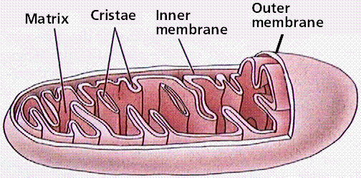
Mitochondria

Slide 51
Mitochondria (4.15)
Function – synthesis of ATP
  3 major pathways involved in ATP production
    Glycolysis - cytoplasm
    Krebs Cycle - matrix
    Electron transport system (ETS) - intermembrane space

Slide 52
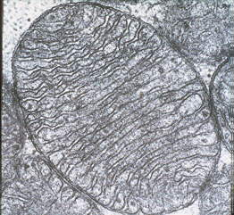
Mitochondria
TEM

Slide 54
Vacuoles (4.12)
Vacuoles are membrane sacs that are generally larger than vesicles.
  Examples:
    Food vacuole - formed when protists bring food into the cell by endocytosis
    Contractile vacuole – collect and pump excess water out of some freshwater protists
    Central vacuole – covered later

Slide 55
Cytoskeleton (4.16, 4.17)
Function
  gives cells internal organization, shape, and ability to move
Structure
  Interconnected system of microtubules, microfilaments, and intermediate filaments (animal only)
    All are proteins

Slide 56
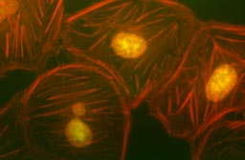
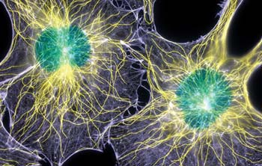
Cytoskeleton

Slide 57
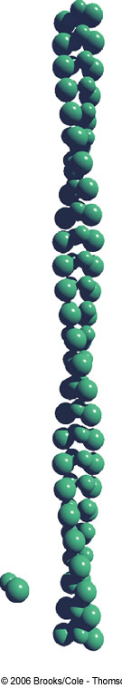
Microfilaments
Thinnest cytoskeletal elements (rodlike)
Composed of the globular protein actin
Enable cells to change shape and move

Slide 58
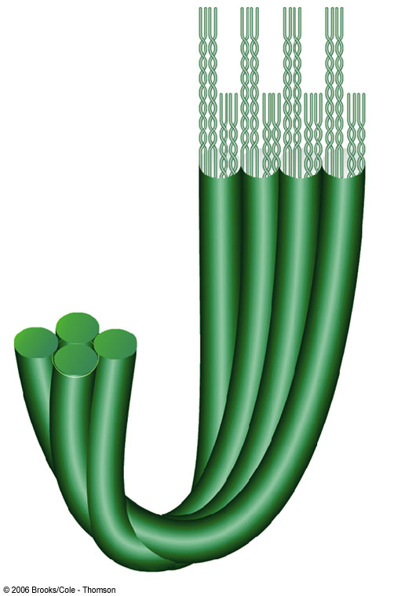
Cytoskeleton
Intermediate filaments
  Present only in animal cells of certain tissues
  Fibrous proteins join to form a rope-like structure
    Provide internal structure
    Anchor organelles in place.

Slide 59
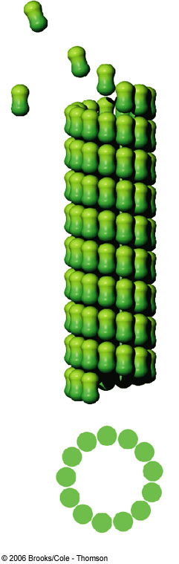
Cytoskeleton
Microtubules – long hollow tubes made of tubulin proteins (globular)
  Anchor organelles and act as tracks for organelle movement
  Move chromosomes around during cell division
    Used to make cilia and flagella

Slide 60
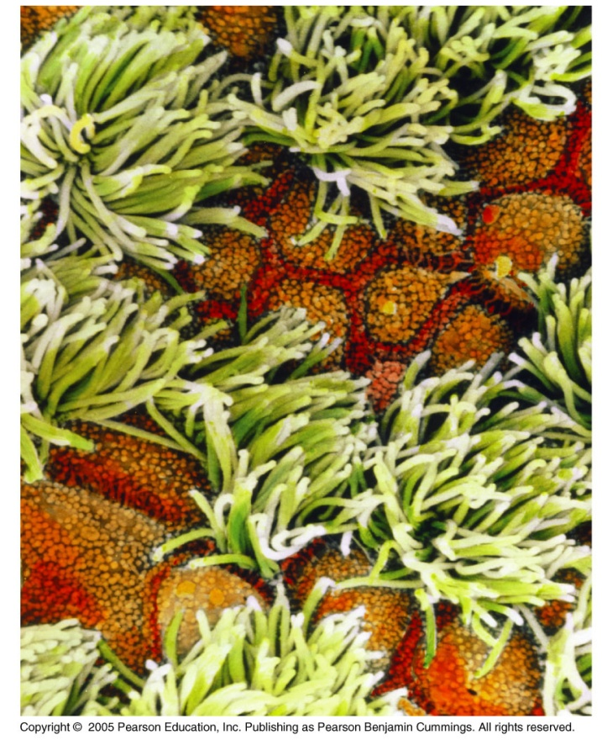
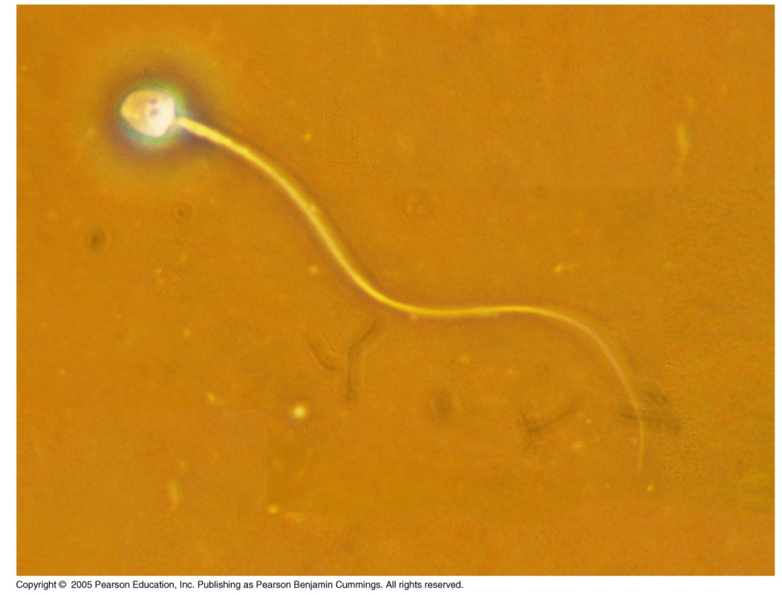
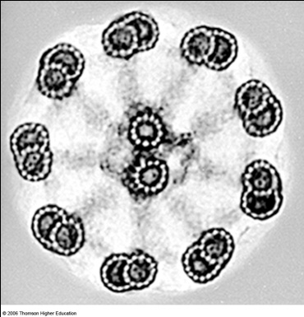
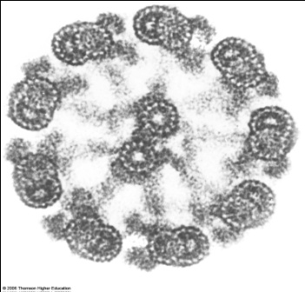
Cilia and flagella (structures for cell motility)
  Move whole cells or materials across the cell surface
  Microtubules wrapped in an extension of the plasma membrane (9 + 2 arrangement of MT)

Slide 61
Plant Cell Structures
Structures found in plant, but not animal cells
  Chloroplasts
  Central vacuole
  Other plastids/vacuoles – chromoplast, amyloplast
  Cell wall

Slide 62
Chloroplasts (4.14)
Function – site of photosynthesis
Structure
  2 outer membranes
  Thylakoid membrane system
    Stacked membrane sacs called granum
  Chlorophyll in granum
  Stroma
    Fluid part of chloroplast

Slide 63
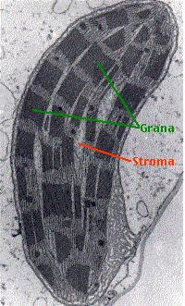

Slide 64
Plastids/Vacuoles in Plants
Chromoplasts – contain colored pigments
    Pigments called carotenoids
Amyloplasts – store starch

Slide 65
Central Vacuole
Function – storage area for water, sugars, ions, amino acids, and wastes
  Some central vacuoles serve specialized functions in plant cells.
    May contain poisons to protect against predators

Slide 66
Central Vacuole
Structure
  Large membrane bound sac
  Occupies the majority of the volume of the plant cell
  Increases cell’s surface area for transport of substances → cells can be larger

Slide 67
Cell surfaces protect, support, and join cells
  Cells interact with their environments and each other via their surfaces
  Many cells are protected by more than the plasma membrane

Slide 68
Cell Wall
Function – provides structure and protection
  Never found in animal cells
  Present in plant, bacterial, fungus, and some protists
Structure
  Wraps around the plasma membrane
  Made of cellulose and other polysaccharides
  Connect by plasmodesmata (channels through the walls)

Slide 69
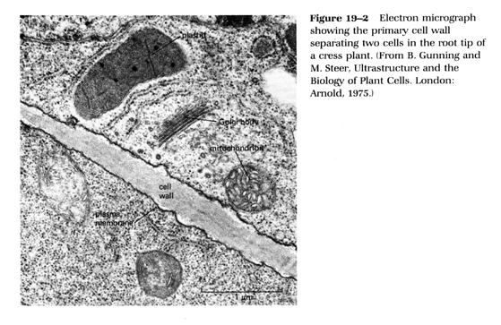
Plant Cell TEM

Slide 70
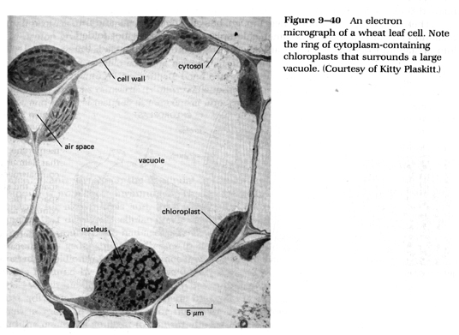
Typical Plant Cell

Slide 71
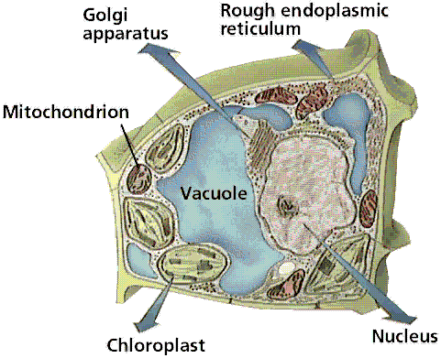
Typical Plant Cell –add the labels

Slide 72
Origin of Mitochondria and Chloroplasts
Both organelles are believed to have once been free-living bacteria that were engulfed by a larger cell.

Slide 73
Proposed Origin of Mitochondria and Chloroplasts
Evidence:
  Each have their own DNA
  Their ribosomes resemble bacterial ribosomes
  Each can divide on its own
  Mitochondria are same size as bacteria
  Each have more than one membrane

Slide 74
Cell Junctions (4.18)
Plasma membrane proteins connect neighboring cells - called cell junctions
  Plant cells – plasmodesmata provide channels between cells

Slide 75
Cell Junctions (4.18)
3 types of cell junctions in animal cells
  Tight junctions
  Anchoring junctions
  Gap junctions

Slide 76
Cell Junctions
Tight junctions – membrane proteins seal neighboring cells so that water soluble substances cannot cross between them
  See between stomach cells

Slide 77
Cell Junctions
Anchoring junctions – cytoskeleton fibers join cells in tissues that need to stretch
  See between heart, skin, and muscle cells
Gap junctions – membrane proteins on neighboring cells link to form channels
  This links the cytoplasm of adjoining cells

Slide 78
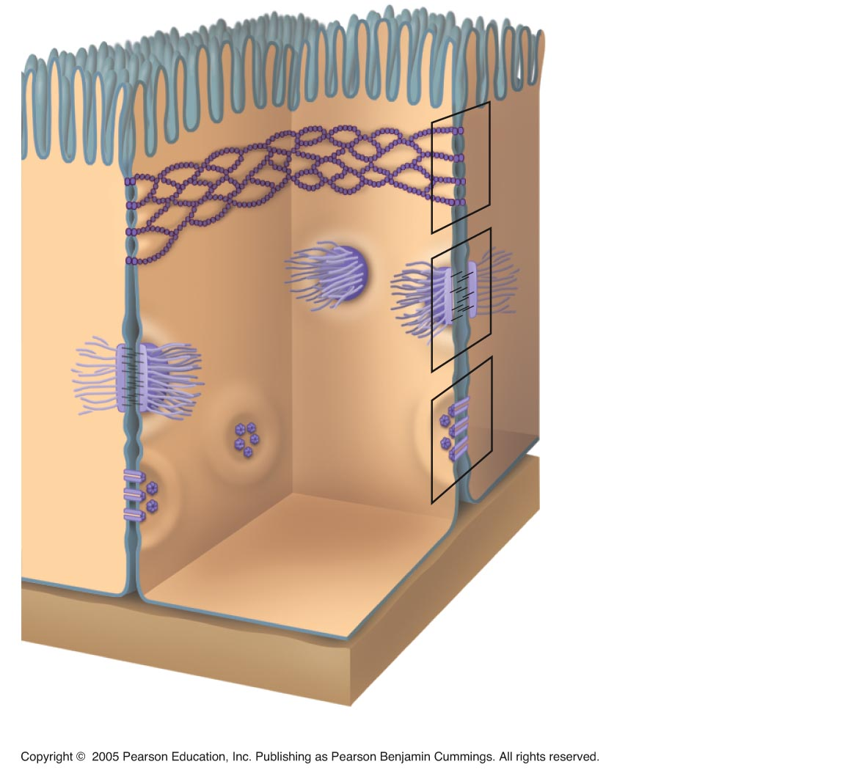
Tight junction
Anchoring junction
Gap junction

Slide 79
Plant Cell Junctions
Plasmodesmata form channels between neighboring plant cells

Slide 80
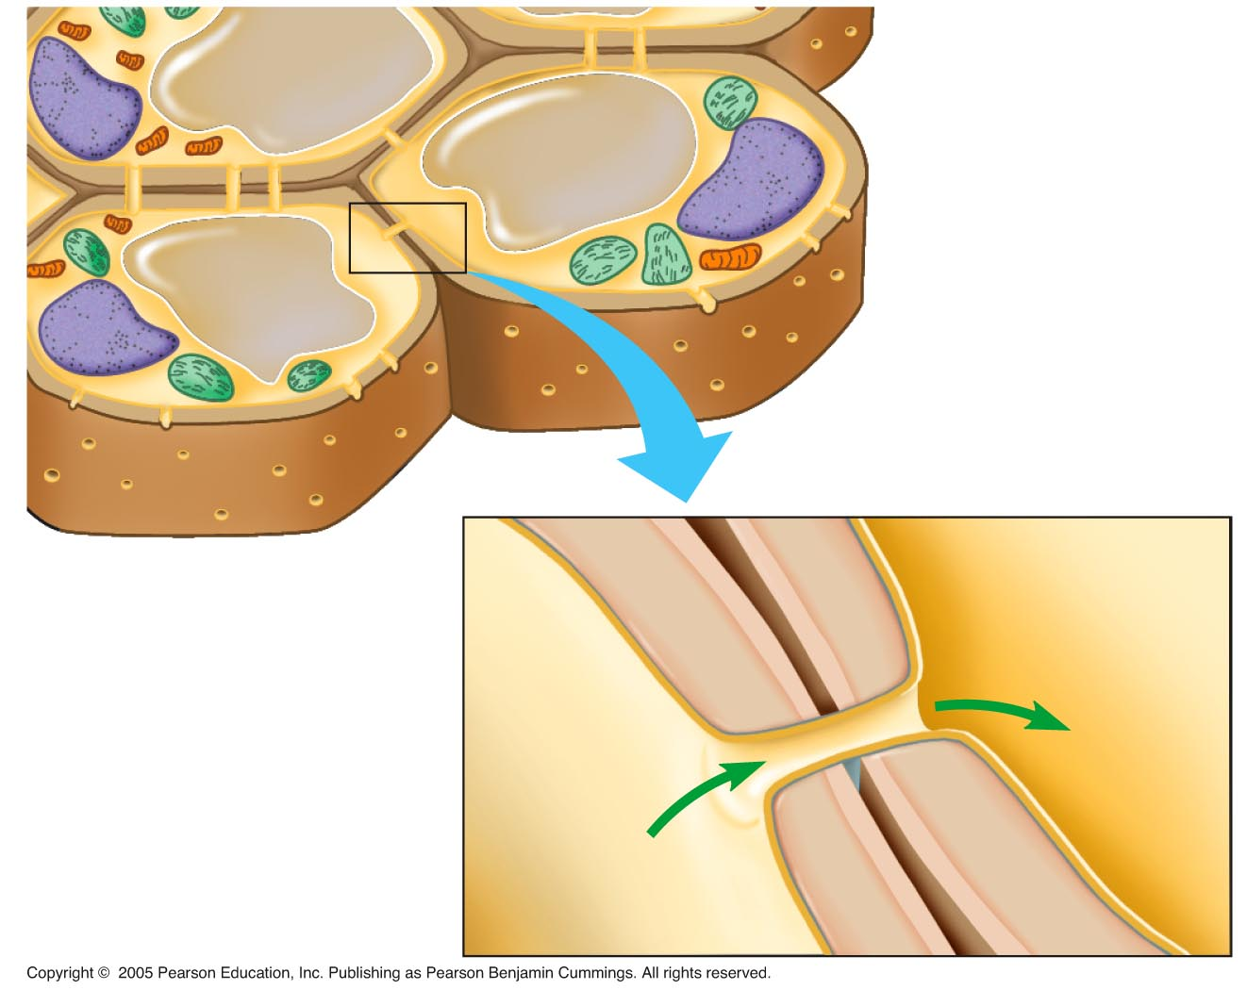
Walls
of two
adjacent
plant cells
Vacuole
Plasmodesmata
Layers
of one plant
cell wall
Cytoplasm
Plasma membrane

Slide 81
Thank You

